Slide 1

Engineering Economics and Financial Management
Lecture 1- INTRODUCTION

Slide 2
In this course
Introduction to Engineering economics
Time Value of Money
Economic Evaluation of alternatives
Replacement analysis
Depreciation
Break-even analysis
Financial Ratios
Risk-benefit analysis and managing risk

Slide 3
In today’s class
What is engineering economics?
Understand the role of engineers in business
Engineering economic decisions
Micro and Macro Economics

Slide 4
As engineers, what is our job?
Engineering :
A profession in which a knowledge of the mathematical and natural sciences is applied with judgment to develop ways to utilize economically the materials and forces of nature for the benefit of mankind.
-ABET

Slide 5
Introduction
What Is Economics ?
The study of how limited resources is used to satisfy unlimited human wants.
What is Engineering Economics ?
The science that deals with techniques of qualitative analysis useful for selecting a preferable alternative from several technically viable ones.

Slide 6
Why engineering economics?
Engineers are confronted with two important interconnected environments, the physical and the economic.
The usual function of engineering is to manipulate the elements of one environment , the physical , to create value in the second environment, the economic.

Slide 7



How engineering relates to utility
The purpose of engineering effort is to determine
how physical factors may be altered to create the
most utility for the least cost.

Slide 8
Importance of Engineering Economics to Engineers:
It Helps in Decision making.
ex:
Engineers mainly deal with the issues of production process, design and the quality.
Engineers must be concerned with the economic aspects of designs and projects they recommend and perform.
To make engineers cost conscious in all their operations.

Slide 9
Common types of Engineering economic decisions
Equipment or process selection
Equipment replacement
New product or product expansion
Improvement in Service and Quality

Slide 10
Decision Making:
The Decision-Making Process
Understand the Problem
Identify the decision criterion
Allocating Weights to the Criteria
Developing Alternatives
Analyzing alternatives
Select the “best” alternative
Implementing
Monitoring

Slide 11
Step 1: Identifying the Problem
Problem
A discrepancy between an existing and desired state of affairs.
Characteristics of Problems
A problem becomes a problem when a manager becomes aware of it.
There is pressure to solve the problem.
The manager must have the authority, information, or resources needed to solve the problem.
Notes:
Bad roads

Slide 12
Step 2: Identifying Decision Criteria
Decision criteria are factors that are important (relevant) to resolving the problem.
Costs that will be incurred (investments required)
Risks likely to be encountered (chance of failure)
Step 3: Allocating Weights to the Criteria
Decision criteria are not of equal importance:
Assigning a weight to each item places the items in the correct priority order of their importance in the decision making process.

Slide 13
Step 4: Developing Alternatives
Identifying viable alternatives
Alternatives are listed (without evaluation) that can resolve the problem.
If good alternatives are missed, the resulting decision is poor.
Step 5: Analyzing Alternatives
Appraising each alternative’s strengths and weaknesses
An alternative’s appraisal is based on its ability to resolve the identified issue.

Slide 14
Step 6: Selecting an Alternative
Choosing the best alternative
The alternative which best suits the requirement is selected.
Step 7: Implementing the Alternative
Putting the chosen alternative into action.
Conveying the decision to and gaining commitment from those who will carry out the decision.

Slide 15
Step 8:Evaluating the Decision’s Effectiveness
The soundness of the decision is judged by its outcomes.
How effectively was the problem resolved by outcomes resulting from the chosen alternatives?
If the problem was not resolved, what went wrong?

Slide 16
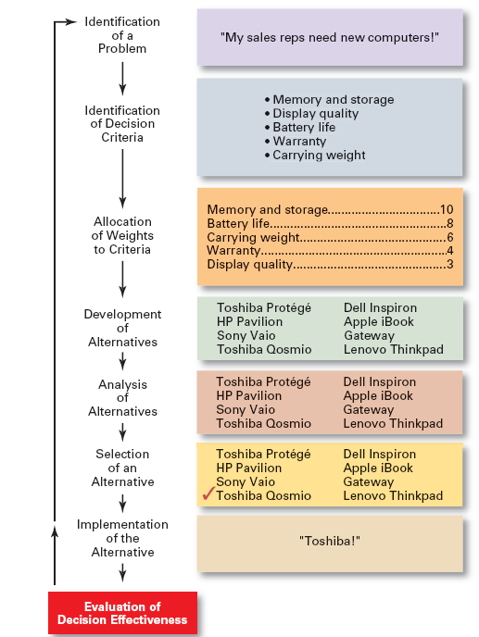
The Decision-Making Process

Slide 17
MACRO AND MICRO ECONOMICS

Slide 18
MACROECONOMICS
Players in an economic system:
Government
Firms/ Businesses/ Corporates
Household/ citizens
Financial system/ Central banks
Macroeconomics examines the aggregate behavior of the economy (i.e. how the actions of all the players in the economic system interact to produce a particular level of economic performance as a whole).

Slide 19
MACRO ECONOMICS
It focuses on issues such as
GDP
Unemployment
Inflation
Deficit
Economic policies
Economic growth and other related issues, which affect the economy as a whole.
These concepts are not simple & direct.

Slide 20
MICROECONOMICS
Microeconomics is the study of individuals, households and firms' behavior in decision making and allocation of resources.
Microeconomic study deals with issues like
what choices people/ firms make,
what factors influence their choices
how their decisions affect the goods markets by affecting the price, the supply and demand.

Slide 21
Micro and Macro Economics
Definition and Differences
MICRO
MACRO
Microeconomics is the study of particular markets, and segments of the economy.
Examples:
Supply and demand in individual markets
Individual consumer behaviour.
Individual labour markets – e.g. demand for labour, wage determination
Macro economics is the study of the whole economy, at an aggregate level.
Examples:
Monetary / fiscal policy. e.g. what effect does interest rates have on whole economy?
Inflation, and unemployment
Economic Growth
International trade and globalisation
Government borrowing

Slide 22

Text books
Contemporary engineering economics
By Chan S Park
Engineering Economics
By James L Riggs
Engineering economic Analysis
By Donald G Newnan
Engineering economy
By Thuesen and Fabrycky

